Slide 1
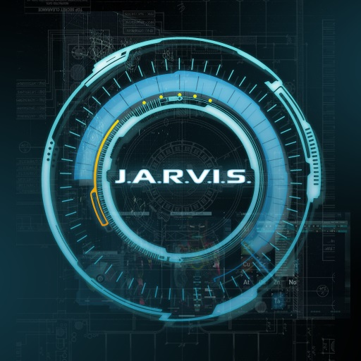
J.A.R.V.I.S.
Team Name: D.I.T Avengers
Céin O'Rourke, Jordan Forde, Daniel Tilley, Éanna Brennan, Andrew Leech

Slide 2
Table of contents
Biographies
History of J.A.R.V.I.S
About J.A.R.V.I.S
J.A.R.V.I.S users
Pros and cons
J.A.R.V.I.S vs other OS
Desktop
User interaction
Conclusion

Slide 3
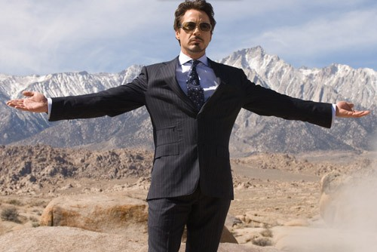
Tony Stark
Genius, Billionaire,
Playboy, Philanthropist
MIT
Stark Industries
Kidnapped by Terrorists
Chest Piece

Slide 4
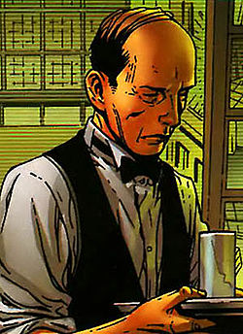
Edwin Jarvis
Was part of the Canadian
Royal Air Force
Butler for the Stark family
Former boxing champion

Slide 5
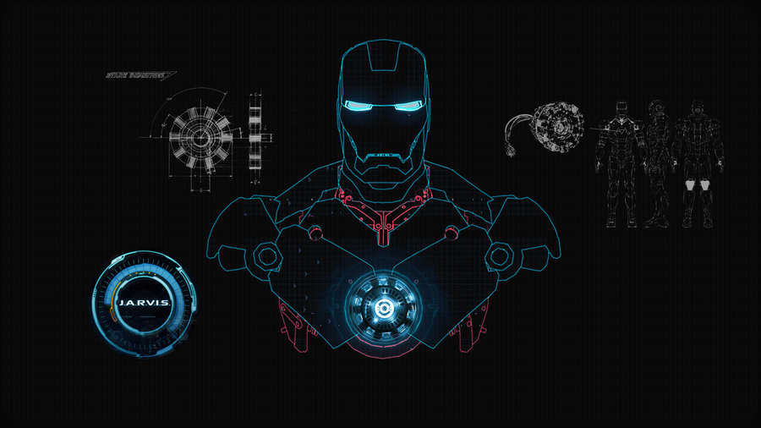
History of J.A.R.V.I.S
Just a Rather Very
Intelligent System
Edwin Jarvis
Iron Man suit

Slide 6
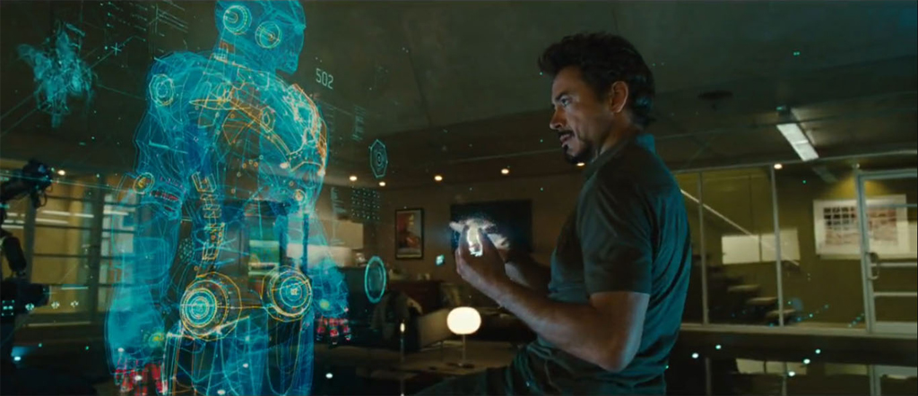
J.A.R.V.I.S Personality
Very Sarcastic
Interacts like a
human
Mocks Tony Stark
Very kind
Helps Tony with
personal issues

Slide 7

J.A.R.V.I.S Communication
Thought that J.A.R.I.V.S
is run off a satellites
Responds to users
thoughts
Uses Holograms as
its interface and
voice input

Slide 8
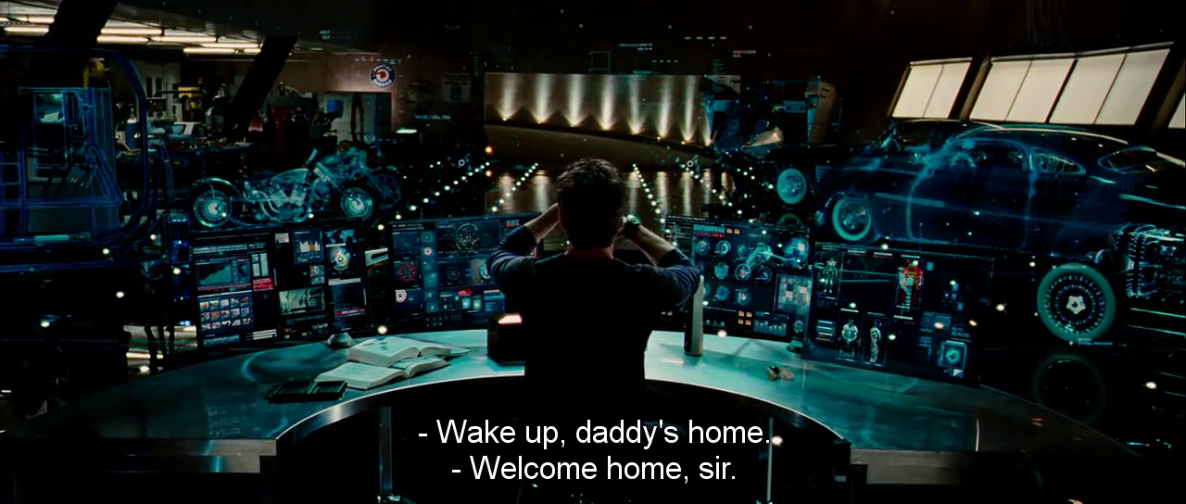
J.A.R.V.I.S Duties
Assist in lab
Calculations for medical
needs, suit mechanics
Battle strategies

Slide 9
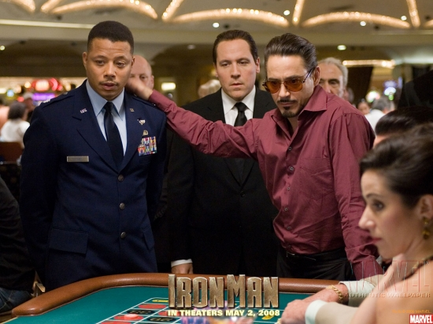
J.A.R.V.I.S Users
Tony Stark – Master and main user
James Rhodes - User
Virginia Potts – User
Odadiah Stane – Enemy
Aldrich Killian – Enemy
Loki Laufeyson – Enemy
Chitauri – Enemies
Leviathan - Enemy

Slide 10
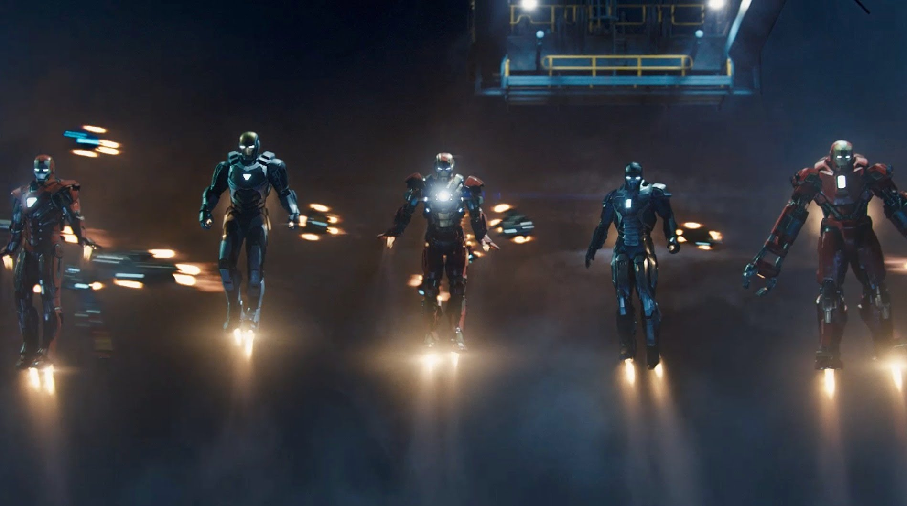
J.A.R.V.I.S Pros
Very Powerful
Can Process lots of data quickly
Can be used for almost anything
Easy to use

Slide 11
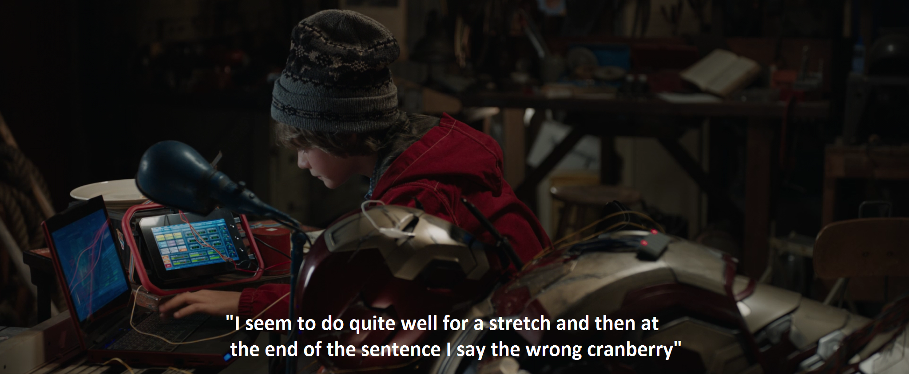
J.A.R.V.I.S Cons
Chance it can malfunction
Only Tony knows how J.A.R.I.V.S works

Slide 12
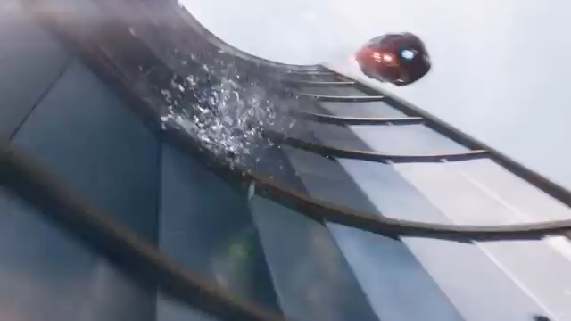
J.A.R.V.I.S vs Windows
J.A.R.I.V.S far more powerful
Much more simplistic to use
Can handle tasks more efficently
What if Windows controlled everything?

Slide 13
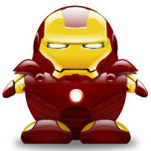

J.A.R.V.I.S vs Linux
Too many types to compare
Combine differet OS to make J.A.R.V.I.S?
J.A.R.V.I.S can do many tasks vs Linux
Maybe J.A.R.V.I.S is a type of Linux

Slide 14

Desktop

Slide 15
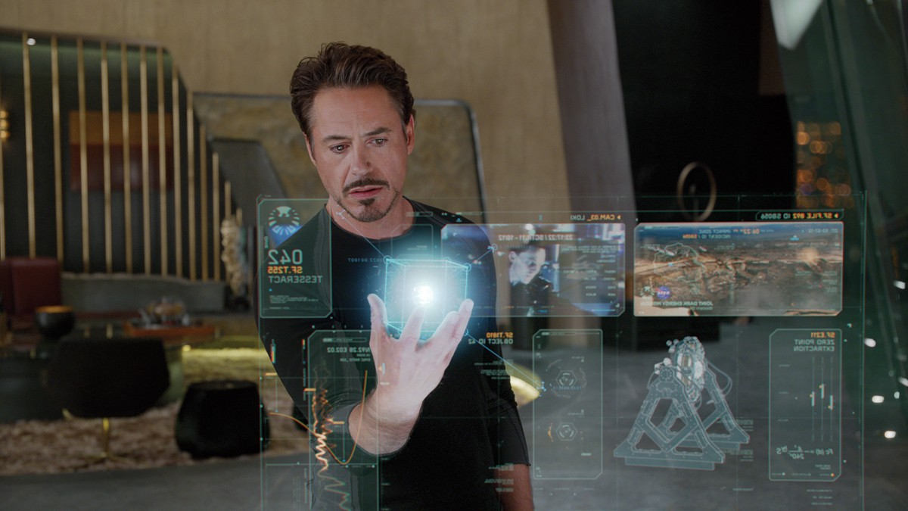
PC
Screens are holograms. Hands used to
Control OS along with voice.

Slide 16
PC
Holograms can also be displayed and
interacted with in 3D.

Slide 17
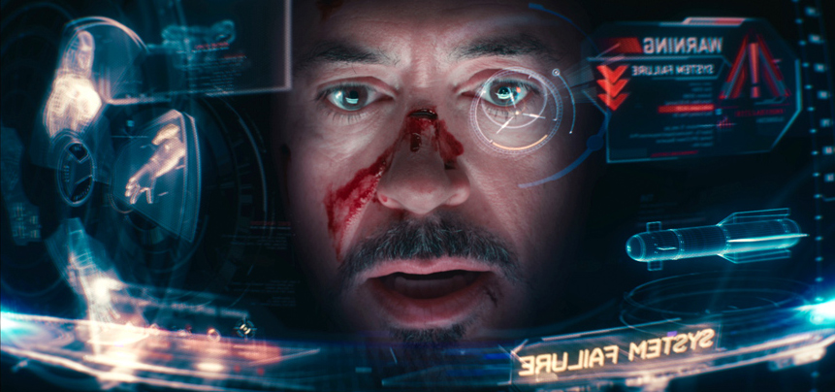
HUD
Head-up display active while wearing
Iron man suit shows all information Tony
needs at the time

Slide 18
HUD
Visual display of suit can show Tony
Information on the status of each part
Of his iron man suit

Slide 19
HUD
Visual display of threths and information
On them are often shown as tony is
Constantly in confrontation

Slide 20
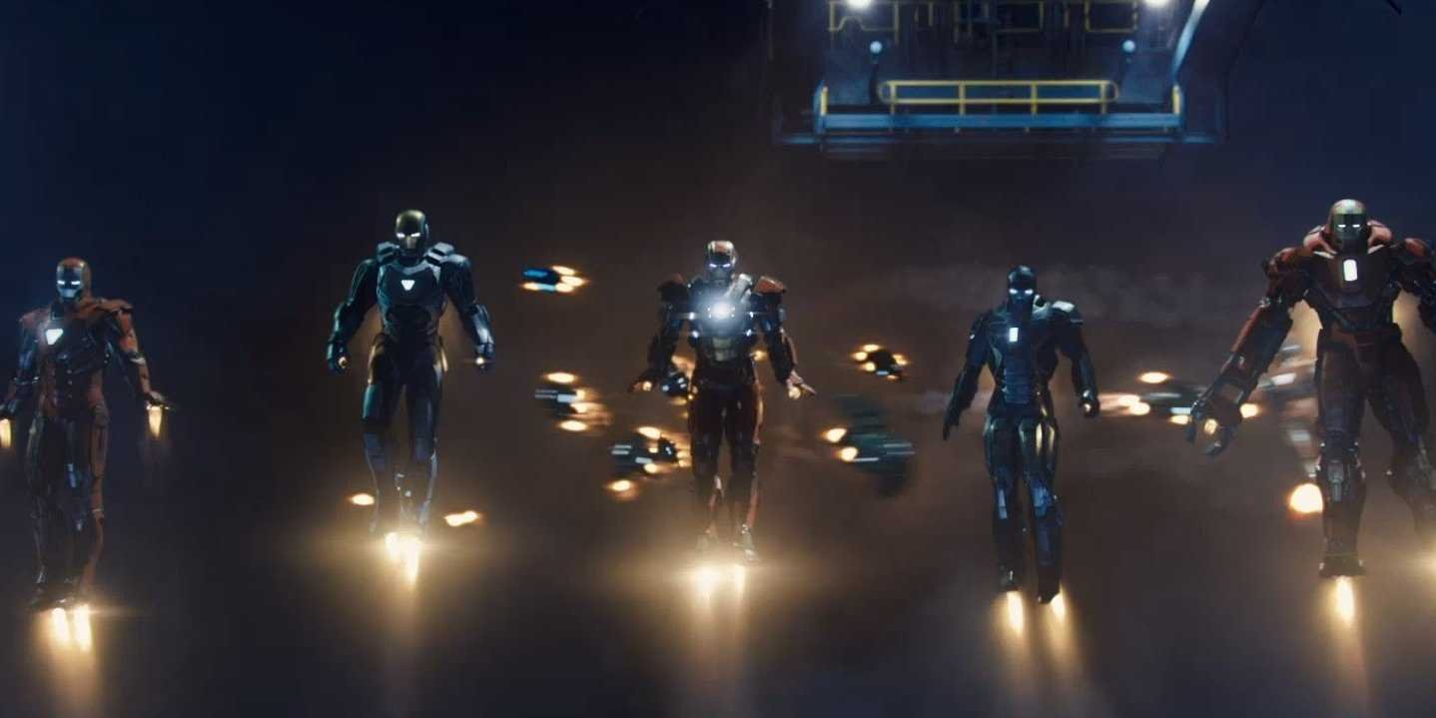
Conclusion
J.A.R.V.I.S is a badass OS

